Slide 1
Solving the hard problems of User Experience Management
@AloisReitbauer

Slide 2
I am an engineer …

Slide 3
There are no problems …

Slide 4
Only challenges

Slide 5
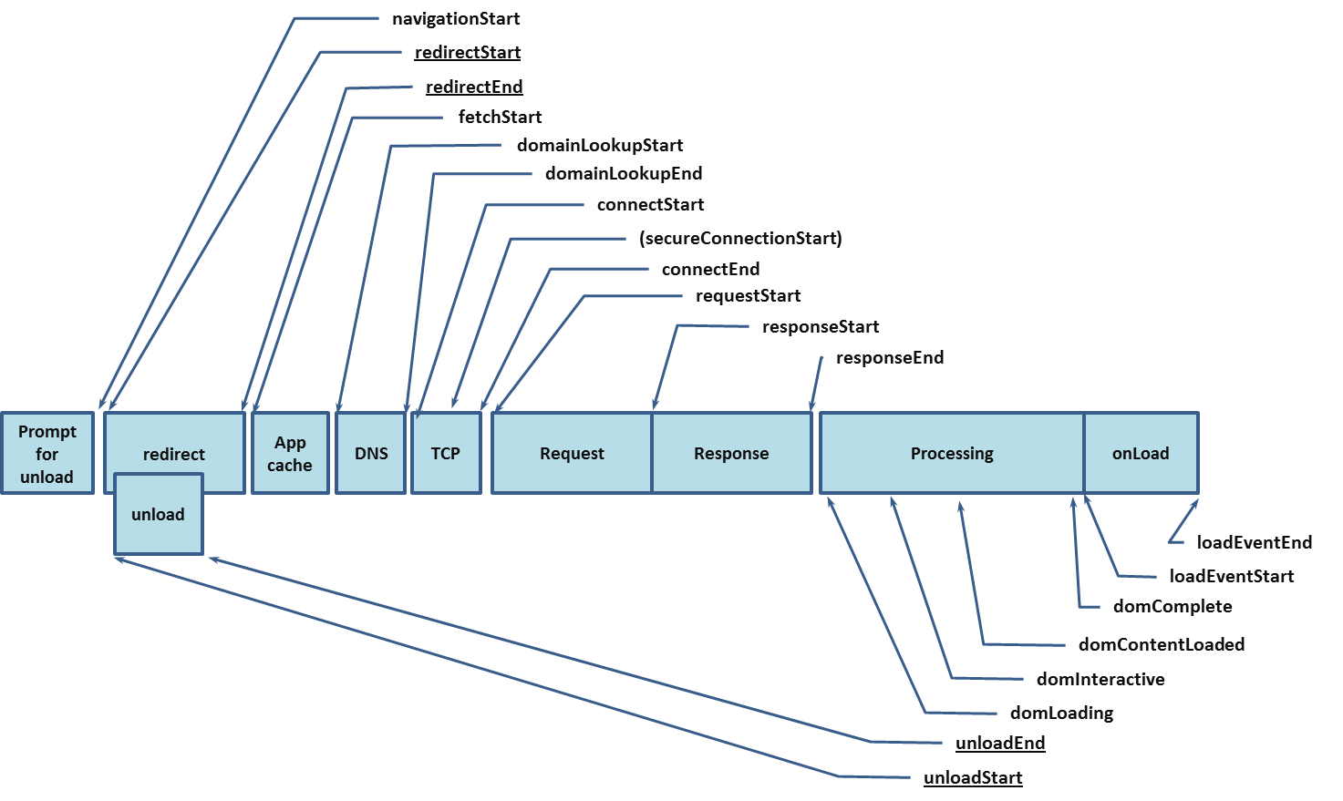
Web Timing made our live easier

Slide 6


Slide 7
Questions #1
How can I get insight into CDNs and Third Parties

Slide 8
Challenge
Not part of your infrastructure

Slide 9
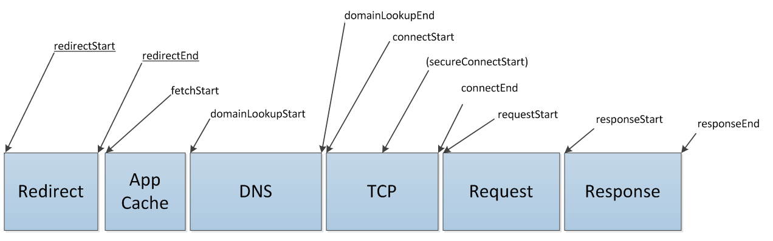
Challenge
Not implemented yet

Slide 10
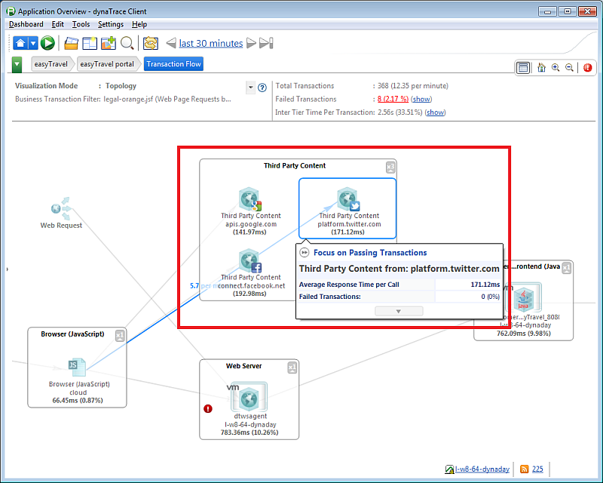
Solved

Slide 11
Questions #2
How can I get actual rendering times

Slide 12
Challenge
How know when the page is rendered?

Slide 13
Challenge
How to do this without a dev. tool?

Slide 14
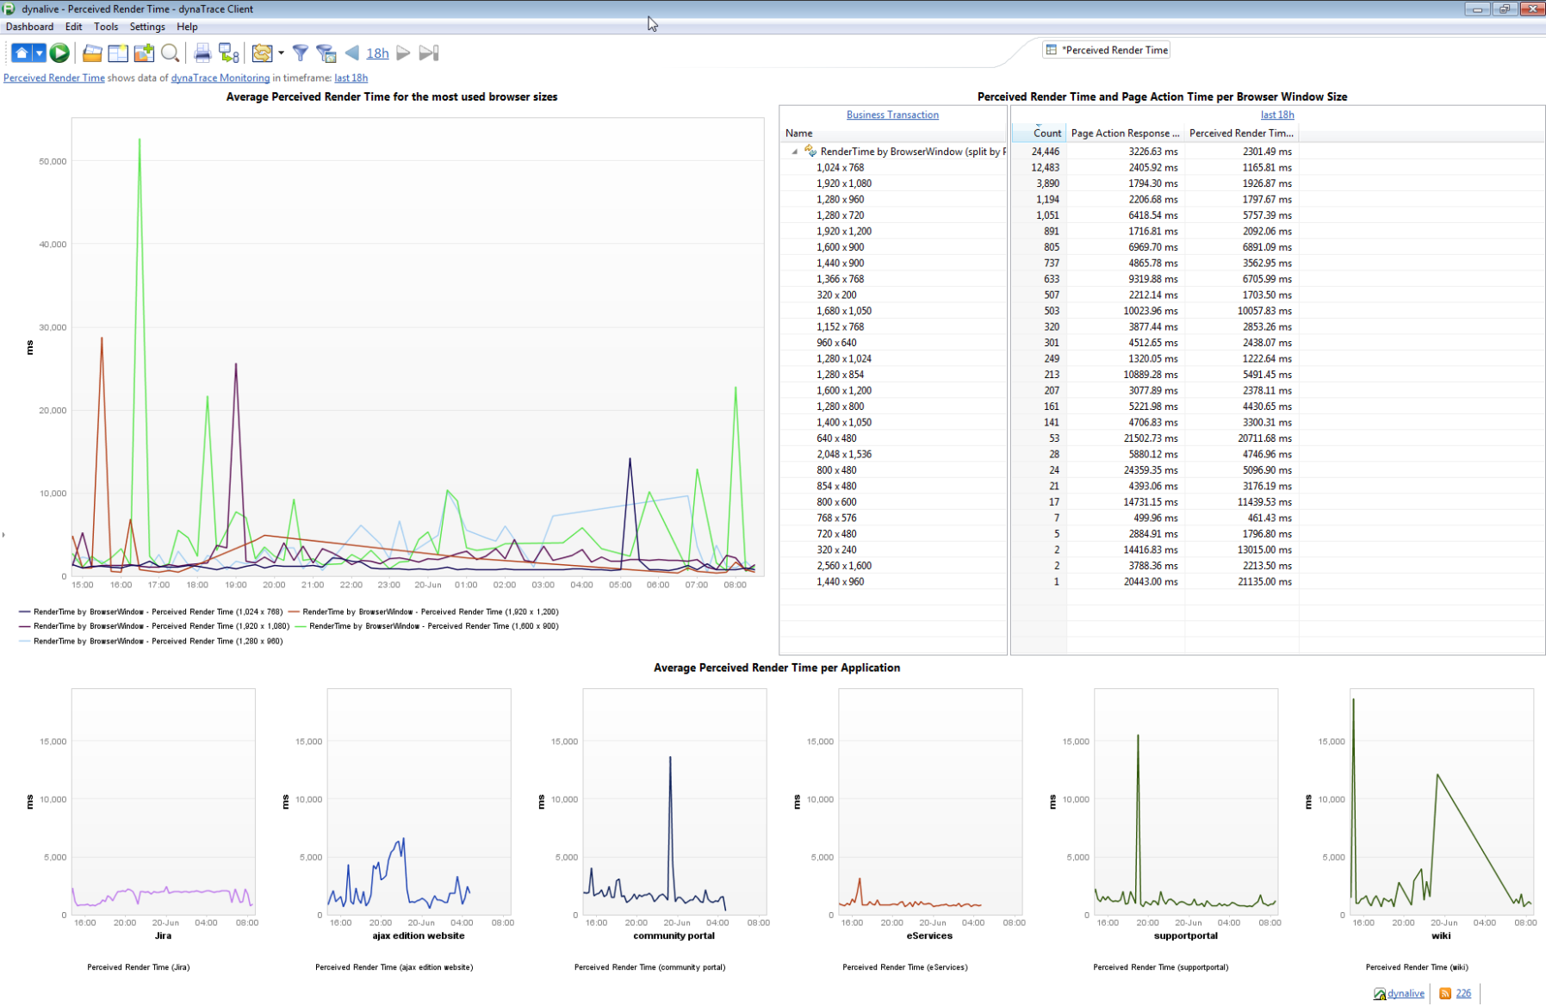
Solved

Slide 15
Question #3
How can I get the monitoring JS into my page

Slide 16
Challenge
Do not want to change my pages

Slide 17
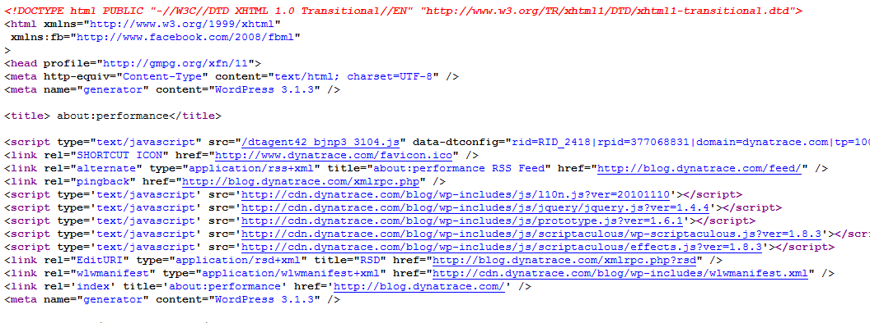
Solved

Slide 18
Questions #4
Why did Maria have a problem with the site?

Slide 19
Challenge
Who is “Maria”?

Slide 20
Challenge
What did she do exactly?

Slide 21
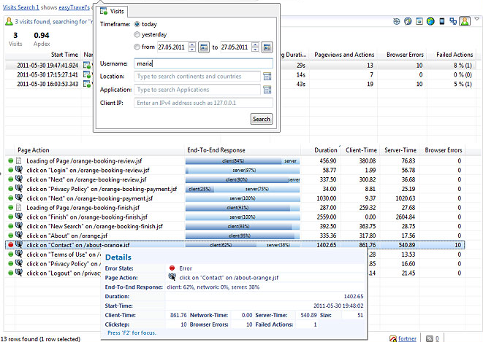
Solved

Slide 22
Question #5
How can get user actions in single page web apps?

Slide 23
Challenge
Web Timing Data is not enough

Slide 24
Challenge
Manual Instrumentation = ☹

Slide 25
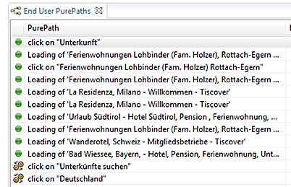
Solved

